Slide 1
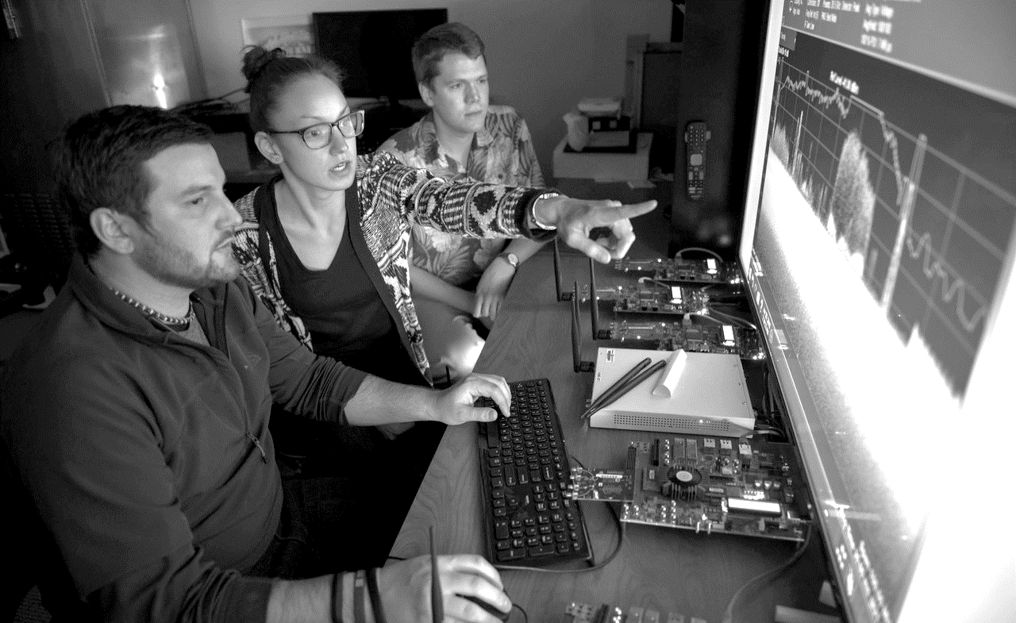
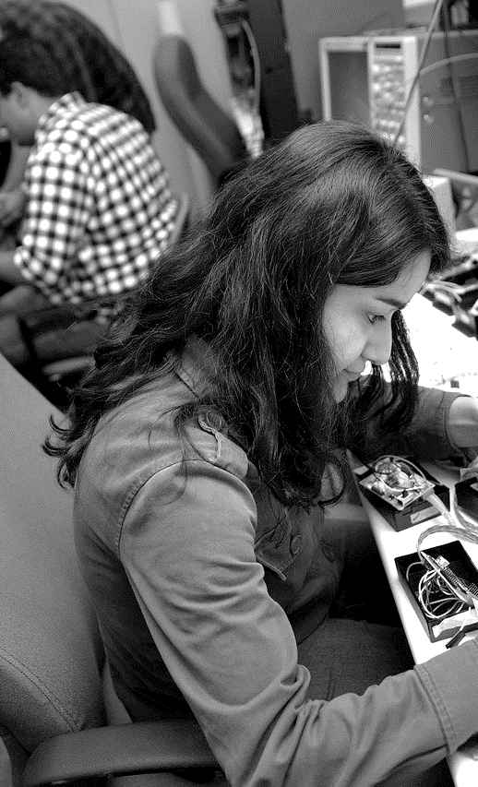
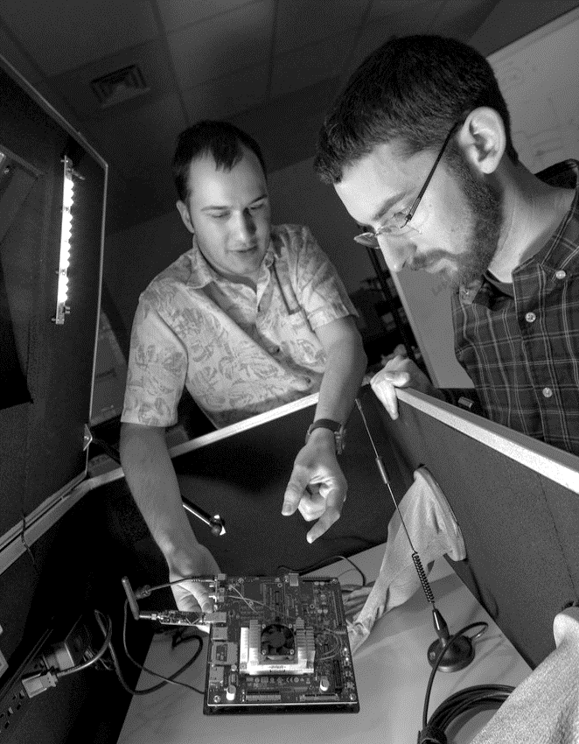

Unsupervised Learning
Daniel Sobien
September 29, 2023

Slide 2
Unsupervised Machine Learning
Overview
Introduction on unsupervised learning, and how it differs from supervised learning
Dimensionality reduction overview and example
Clustering overview and example
Sticking points, i.e., the difficulties and subjectivity of unsupervised learning
Jupyter-Notebook example with each section, and a final application example at the end

Slide 3
Learning Objectives
Understand how unsupervised and supervised learning is different
Analyze results for PCA and t-SNE dimensionality reduction
Evaluate K-Means clustering results and tweak to get better results
Understand the difficulty and subjectivity in the results
Use dimensionality reduction to build a better classifier

Slide 4
Unsupervised Learning Overview

Slide 5
Discussion Questions
What is unsupervised learning? How does it differ from supervised learning?
Why might we want to use unsupervised learning?

Slide 6
Unsupervised Learning
Unsupervised learning does not use labeled data.
Supervised learning uses labeled data to train models to predict the label on new data.
The goal of unsupervised learning is to find and learn patterns in data
These patterns may be irrelevant to any labels or categories of the data
Patterns are often how similar or different data points are

Slide 7
Motivation
Most data is unlabeled, but we still want to make use of it.
Unsupervised learning is the “cake” of machine learning:
“If intelligence is a cake, the bulk of the cake is unsupervised learning, the icing on the cake is supervised learning, and the cherry on the cake is reinforcement learning.” – Yann LeCun [2, 7]
Machine learning is not just about predicting, it’s more about finding patterns within the data that are meaningful.
The challenge is knowing if the algorithms has learning something useful [1].

Slide 8
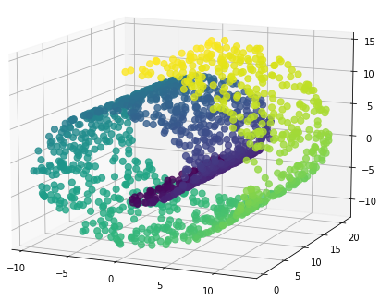
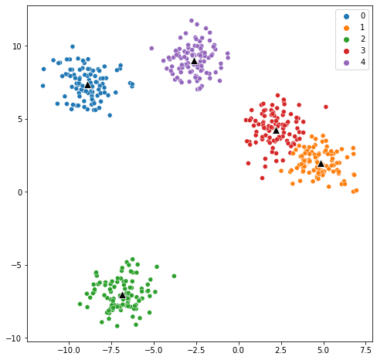
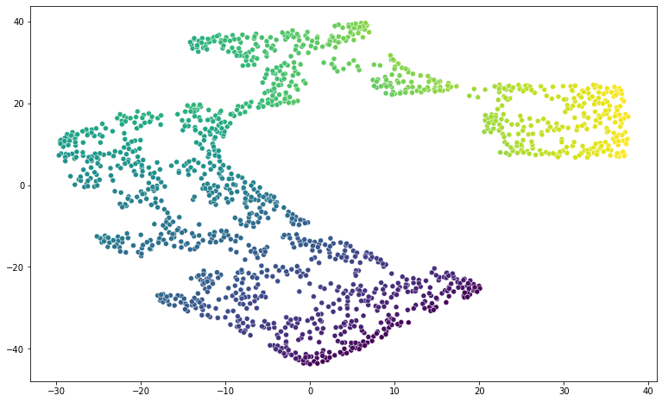
Types of Unsupervised Learning
Dimensionality Reduction
finds a lower dimensional representation of the data that is still meaningful
Clustering
finds groups of the data that are meaningful, where samples in groups are similar to each other but different from other groups

Slide 9
Evaluation
Because there are no labels, evaluation is a major challenge
So how do you determine that an algorithm is working well?
Benchmark dataset with ground truth[1], but not indicative of real-world data.
Some metrics don’t require ground truth, like Silhouette scores [1], but often makes assumptions about what a “good” cluster should look like.
Often the best, or only way, is to manually assess the results [1].

Slide 10
Applications
Dimensionality reduction
Decomposition
Preprocessing for classification or clustering
Compression
Visualization
Clustering
Finding hidden patterns and structure in the data
Finding groups in the data, “classification”
Outlier/anomaly detection

Slide 11
Discussion Question
Turn to first notebook example: use both random forest classifier (supervised) and K-means clustering (unsupervised) on the data
What differences do you notice in the results?
Which model do you think is better? Which model answers what types of questions about the data?

Slide 12
Dimensionality Reduction

Slide 13
Discussion Question
Let’s assume your boss gives you a high dimensional dataset and you need to make some insights on it for an meeting in an hour. You’re unfamiliar with this type of data, but think that dimensionality reduction is the way to start. What are some of the benefits dimensionality reduction can give you in this short time window?

Slide 14
Dimensionality Reduction Overview
Converts high dimensions (features/columns) to lower dimension, often referred to as the latent space
Motivation: dimensionality reduction can deal with the curse of dimensionality, help visualize, and speed up training of other algorithms [2]
Types [1, 3]:
Projection
Manifold Learning
Feature Extraction
Deep Learning

Slide 15
PCA – Intro and motivation
One of the most commonly used unsupervised algorithms. It works by linearly projecting data from a higher to lower dimension in a way that preserves variance of the data [10, 3].
PCA uses eigenvalue decomposition on the data [2].
While fundamentally dimensionality reduction, used for visualizing or selecting a subset of meaningful features, can do a whole lot more [10].
Feature extraction [1, 10]
Noise filtering [10]
Data compression [3]

Slide 16
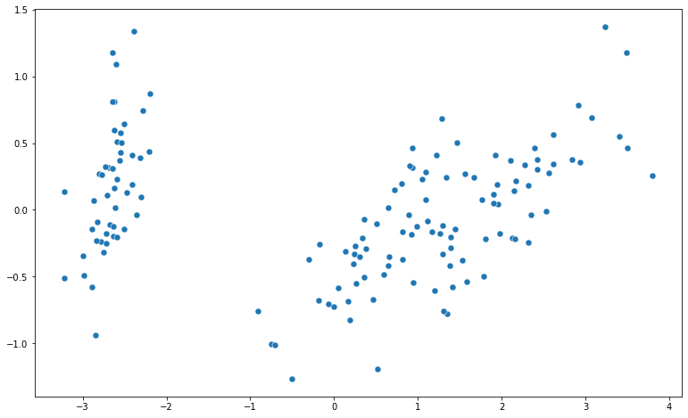
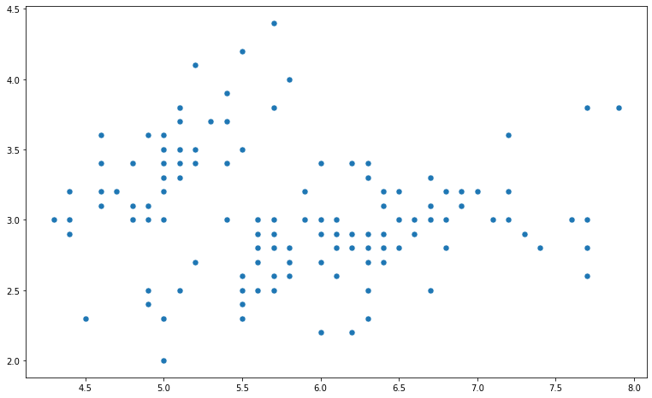
PCA – Details
Projecting 4D Iris dataset into 2D
Can see it exaggerate the variance in the data

Slide 17
t-SNE and Manifold Learning
Manifold learning is non-linear mapping for more complicated data, but primarily only used for visualization in 2 or 3D [1, 2].
It can find a lower dimensional topology/surface embedded within your higher dimensional data and project into lower dimensions.
Works by preserving distance between points in the original space [1].
It really only serves the purpose of visualization because it cannot transform new data points [2].
If this is needed there are algorithms like UMAP that can accomplish

Slide 18
t-SNE and Manifold Learning

Slide 19
Dimensionality Reduction Applications
Decomposition to fewer dimensions for:
Easier visualization; including to assess labeled data for classification
Other ML algorithms, such as clustering and classification
PCA has ability to inverse transform:
Anomaly detection or noise filter
t-SNE is more powerful tool than PCA , especially if data is non-linear, but mostly useful for visualization and decomposition.
Hyperparameter tuning means it’s backup option if PCA doesn’t work well
Slow for very high dimensions or lots of samples

Slide 20
Evaluating Dimensionality Reduction
Not any metrics; just plot and assess the results.
Do you see clear patterns in the data?
Can we plot features (or labels) as colormap and the results make sense?
If using it for a specific task, evaluate that task with and without
E.g., for classification, evaluate speed with and without and the performance with and without; if it speeds up training without losing too much performance then it’s good.
Less direct and more “does this work for my application?”

Slide 21
Discussion Question
Now let’s take a look at the dataset from your boss and run both PCA and t-SNE on it. Compare and contrast the results for the two approaches, which method seems to work better for this dataset? Why?

Slide 22
Clustering

Slide 23
Discussion Question
After looking at the data you suppose it can be grouped together, but there are no labels. How does clustering help you in this situation, besides just because the data is unlabeled? What sorts of applications can you think of for this process?

Slide 24
Clustering
Finding patterns and structure in the data
We have to assess features within each cluster to see how they differ, but it can reveal combinations of similar features
Prototype
Hierarchical
Density
Gaussian mixture
Not always obvious which clustering algorithm to use upfront, it takes domain knowledge of the problem to help guide and assessing different results to determine what is best [2]

Slide 25
K-Means – Intro and Motivation
One of the most simple and commonly used clustering algorithms [1].
Groups data on similarity, and assigns a cluster label, analogous to classification except that labels have no a priori meaning [1].
Prototype-based, meaning each cluster is represented by a prototype data point, for K-means that is the mean that defines the center [2].
Can only find simple, spherical shaped clusters in the data [1], and doesn’t work well with different shapes [3].
No guarantee that it finds a global optimal solution [10].
Have to specify the number of clusters.

Slide 26
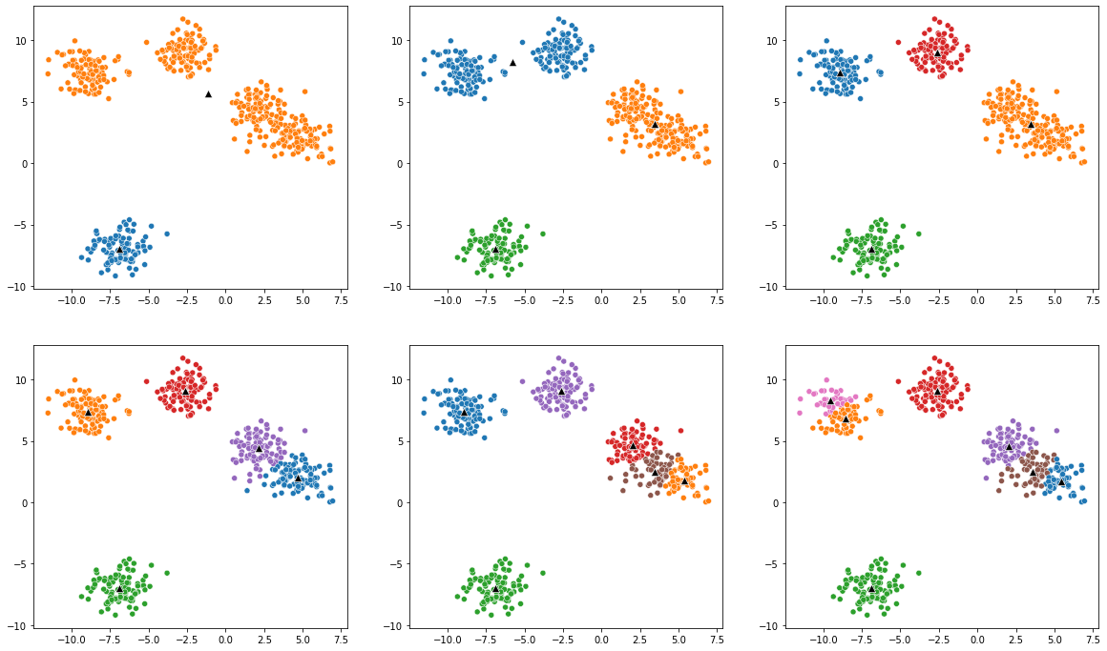
K-Means – Determining Number of Clusters
2 Clusters
3 Clusters
4 Clusters
5 Clusters
6 Clusters
7 Clusters

Slide 27
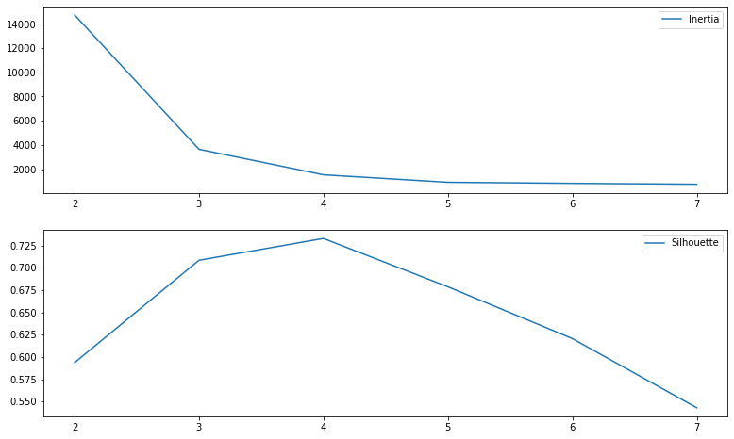
K-Means – Determining Number of Clusters
Elbow curve
Sum of squares of each point from center
Silhouette analysis
Measures ratio of distance of points within a cluster to nearby clusters

Slide 28
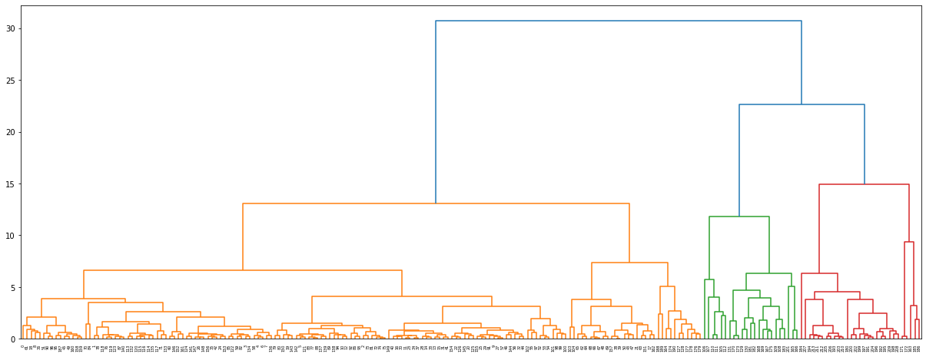
Hierarchical – Intro and Motivation
Method that clusters without requiring the number of clusters a priori.
Based on distances between points to create a meaningful taxonomy of the data [2], which can be visualized as a dendrogram [1].
Dendrogram gives us the chance make an informed choice on the number of clusters by showing breakdown of potential clusters [7, 9].

Slide 29
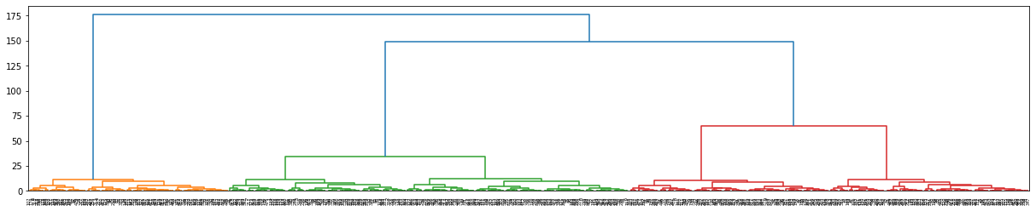
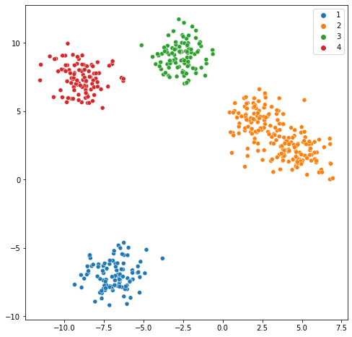
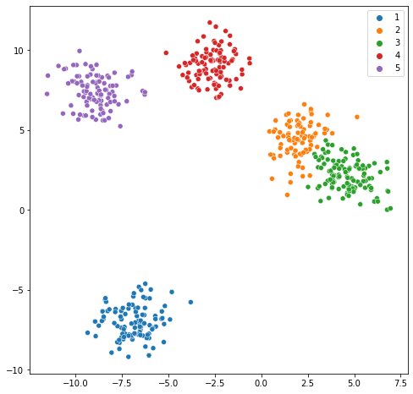
Hierarchical – Dendrogram
Choose a distance to slice the dendrogram and get the clusters at that cross section.
Sliced at 50
Sliced at 25

Slide 30
Hierarchical – Evaluation and Application
Dendrograms give us a natural way to assess performance while also helping understand the data and choose the number of clusters.
Besides creating clusters, it forms this organization of the data that relates distances between all of the data points.

Slide 31
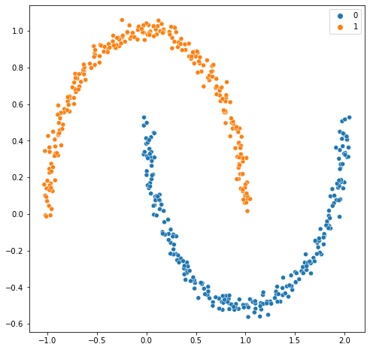
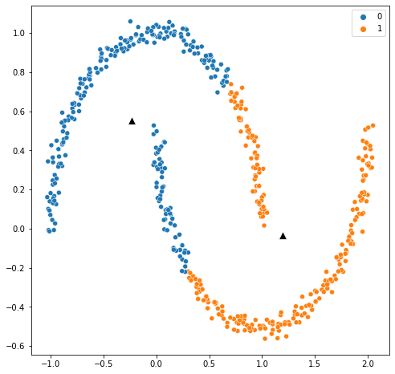
DBSCAN – Intro and Motivation
DBSCAN
Does not require number of clusters a priori.
Based on density, can find complex shapes and outliers [1, 2].
Makes assumption that data is structured as “high-density regions separated by low-density ones” [8].
Works well on data that has similar density clusters and low dense regions between clusters [3].
Has difficulty clustering in higher dimensions, because the will tend to be sparse, but can pair with PCA or t-SNE to help [8].
K-Means

Slide 32
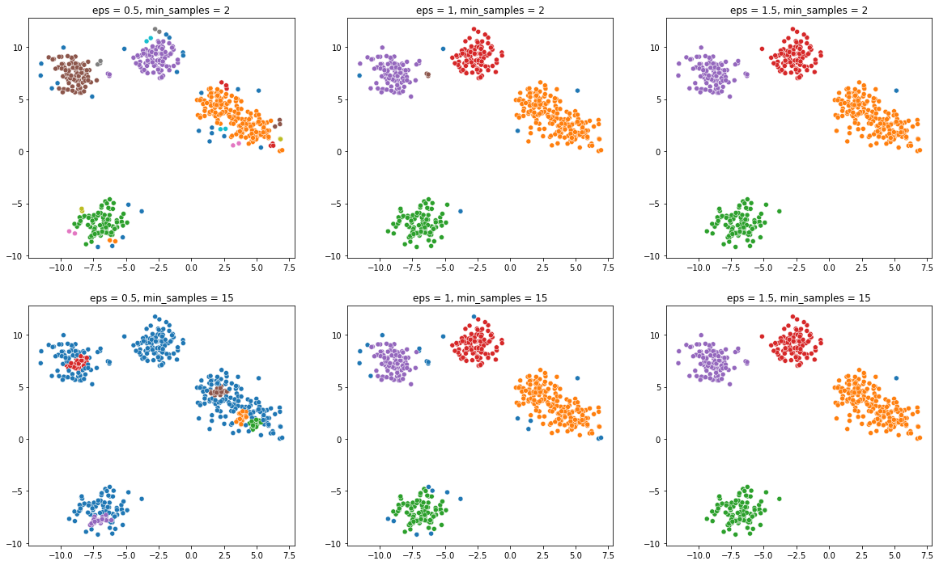
DBSCAN - Examples
Requires some tuning of min samples in a cluster and distance to include points around a cluster

Slide 33
Evaluating DBSCAN
There are not any inherent ways of evaluating DBSCAN
We have to manually check results for tuning the hyperparameters
There are some clustering metrics that can evaluate [8] (pick only a few)
Completeness
Homogeneity
AMI
ARI
Contingency matrix
Calinski-Harabasz

Slide 34
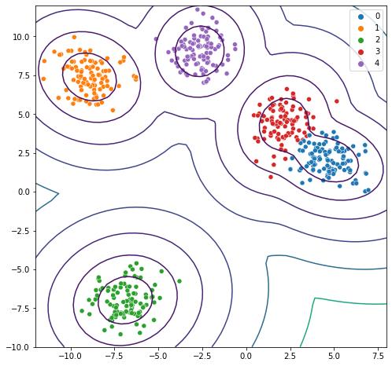
Gaussian Mixtures – Intro and Motivation
Designed to handle the issues of k-means, so instead of spherical clusters it looks for multi-dimensional distributions [10].
Mixes Gaussian distributions for clusters, which also allow it to predict probability of point between clusters and uncertainty [8, 10].
Similar to density estimation (DBSCAN) because probabilities match data density [10].
Can use more cluster to hand complex shapes.

Slide 35
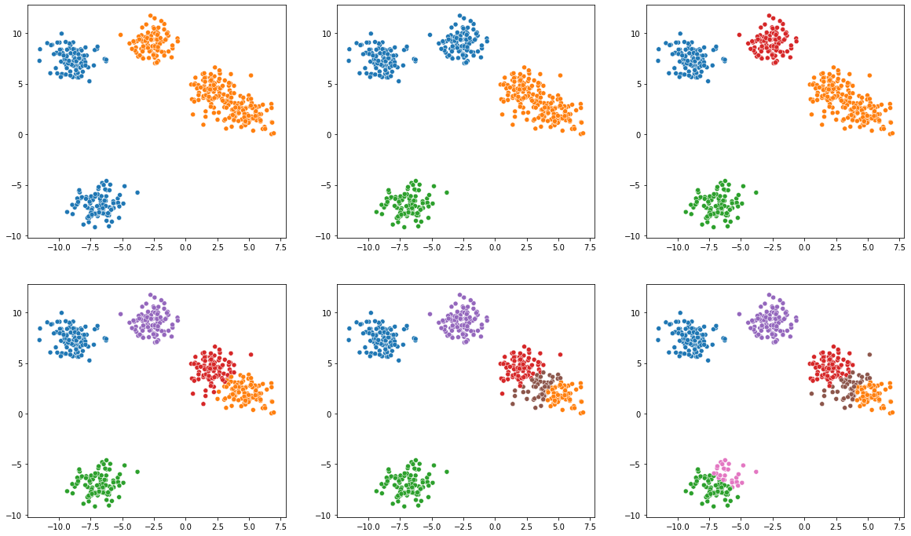
Gaussian Mixtures – Example
2 Clusters
3 Clusters
4 Clusters
5 Clusters
6 Clusters
7 Clusters

Slide 36
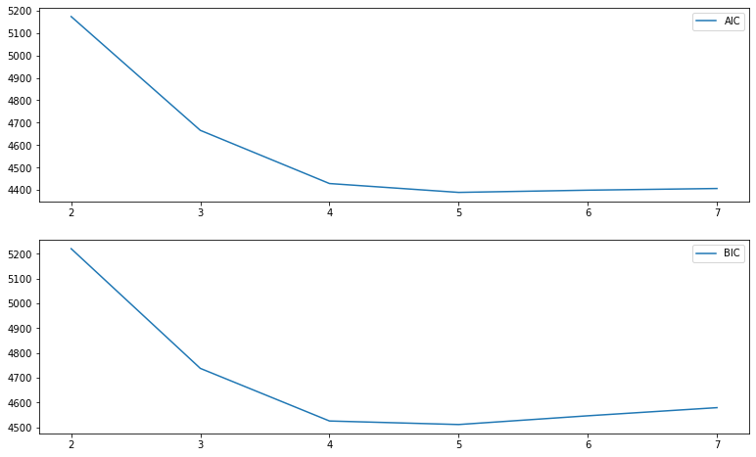
Evaluating Gaussian Mixtures
SciKit-Learn provides Akaike information criterion (AIC) and Bayesian information criterion (BIC); try to minimize both of these values.

Slide 37
Clustering Algorithm Applications
K-Means
Group data into simple clusters based on similarity
Hierarchical
Hierarchical organization of data in dendrogram
DBSCAN
More complex clusters, and don’t need to know how many beforehand
Outlier and anomaly detection
GMM
More complex clusters
Outlier and anomaly detection
Gaussian model of the data, and data generation

Slide 38
Discussion Question
Let’s go back to the data that your boss gave you. You think that there are probably some clusters that exist in the data, but don’t know how many. You are going to use the K-Means algorithm.
How many clusters are in the dataset? Why? How have you justified your answer, or what judgment is it based on?

Slide 39
Sticking Points,
or The Difficulty and Subjectivity of Unsupervised Learning

Slide 40
Discussion Question
Given the difficulty and judgment needed for unsupervised learning, we see that results are open to interpretation. What impacts do you think that has on using these algorithms for different applications?
What is the goal of dimensionality reduction?
What are the assumptions for various clustering algorithms? What does that make them good or not good for?

Slide 41
Difficulty of Dimensionality Reduction
Dimensionality reduction is assessed almost entirely based on visual assessment or if it helps any models that use the reduced data
Luckily dimensionality reduction makes visualization easy, so we can assess, but this is subjective
Best case is groups form in the latent space that match labels, clusters, or features, and we can explain how these features vary inter- and intra-cluster/label

Slide 42
Difficulty of Clustering
Clustering algorithms need number of clusters a priori or some require a little hyperparameter tuning
Hard to determine how many clusters is the correct number
Dendrogram requires extra assessment
DBSCAN needs tuning
Each algorithm has strengths and weaknesses, and the best option depends on the data and application

Slide 43
Metrics
The lack of labels provides no definitive measures of performance
If you do have labels, it’s better to use supervised learning, unless you are trying to see how data is related in terms of features
Visual and manual assessment is often the best default, but takes time
Usually means having a good reduced dimension version for visualizing
Metrics that don’t require ground truth make assumptions on what is the best form of the clusters – often dense clusters with space in between

Slide 44
When to use?
Any time you do not have labels
When you need to visualize (high dimensional) data
Understanding patterns and structure in the data
There are more niche applications:
Image segmentation [3, 10]
Label propagation [3]
Noise filter [3, 6, 10]
Anomaly/outlier detection [3, 7, 8]
GMM can model/generate data [3]
PCA can extract features [10]

Slide 45
Example and Discussion
Try the k-means and hierarchical on the example data and compare the results?
Why might we be getting the results we see?

Slide 46
Questions?

Slide 47
Useful Links
https://scikit-learn.org/stable/modules/clustering.html
https://jakevdp.github.io/PythonDataScienceHandbook/
https://github.com/ageron/handson-ml3/blob/main/09_unsupervised_learning.ipynb
https://github.com/amueller/introduction_to_ml_with_python/blob/master/03-unsupervised-learning.ipynb
https://github.com/abhishekkrthakur/approachingalmost

Slide 48
References
Müller, Andreas C., and Sarah Guido. Introduction to machine learning with Python: a guide for data scientists. " O'Reilly Media, Inc.", 2016.
Raschka, Sebastian, et al. Machine Learning with PyTorch and Scikit-Learn: Develop machine learning and deep learning models with Python. Packt Publishing Ltd, 2022.
Géron, Aurélien. Hands-on machine learning with Scikit-Learn, Keras, and TensorFlow. " O'Reilly Media, Inc.", 2022.
Albon, Chris. Machine learning with python cookbook: Practical solutions from preprocessing to deep learning. " O'Reilly Media, Inc.", 2018.
Foster, David. Generative deep learning. " O'Reilly Media, Inc.", 2022.
Mohri, Mehryar, Afshin Rostamizadeh, and Ameet Talwalkar. Foundations of machine learning. MIT press, 2018.
Patel, Ankur A. Hands-on unsupervised learning using Python: how to build applied machine learning solutions from unlabeled data. O'Reilly Media, 2019.
Bonaccorso, GiuseppePatel. Hands-on unsupervised learning using Python: Implement machine learning and deep learning models using Scikit-Learn, TensorFlow, and more. Packt Publishing Ltd, 2019.
Johnston, Benjamin, Aaron Jones, and Christopher Kruger. Applied Unsupervised Learning with Python: Discover hidden patterns and relationships in unstructured data with Python. Packt Publishing Ltd, 2019.
VanderPlas, Jake. Python data science handbook: Essential tools for working with data. " O'Reilly Media, Inc.", 2016.

